Slide 1
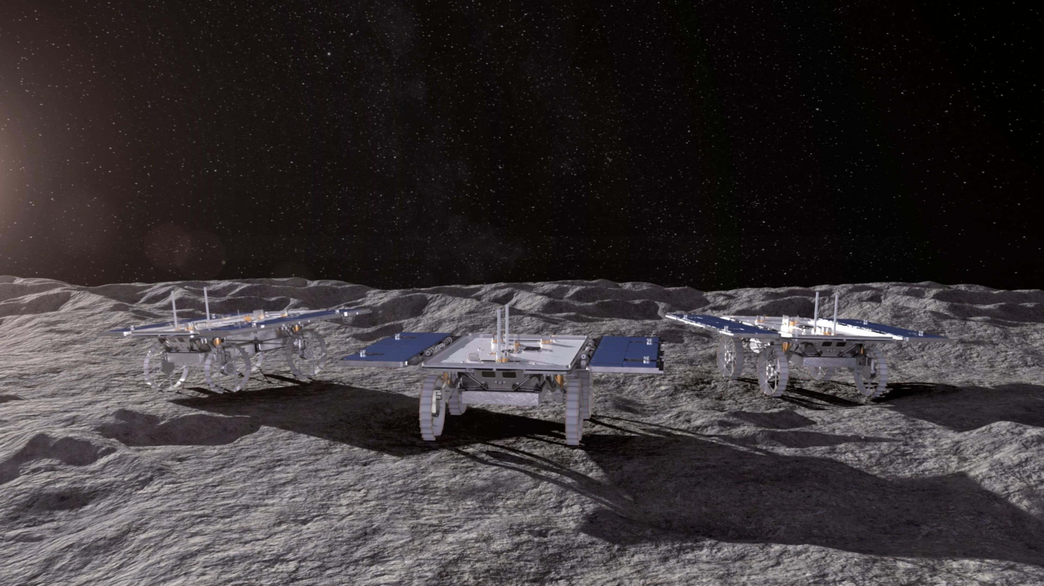
Digital Twin Interoperability Demonstration Use Case
Cislunar & Lunar Digital Twin Workshop
April 21st , 2025

Slide 2
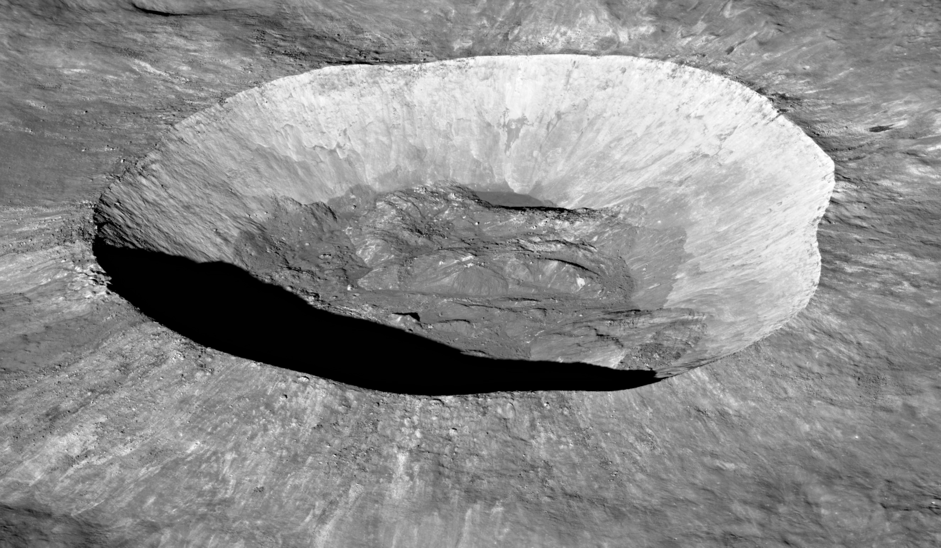
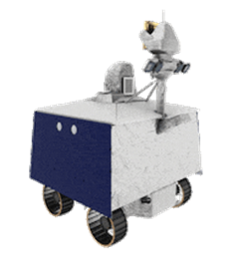
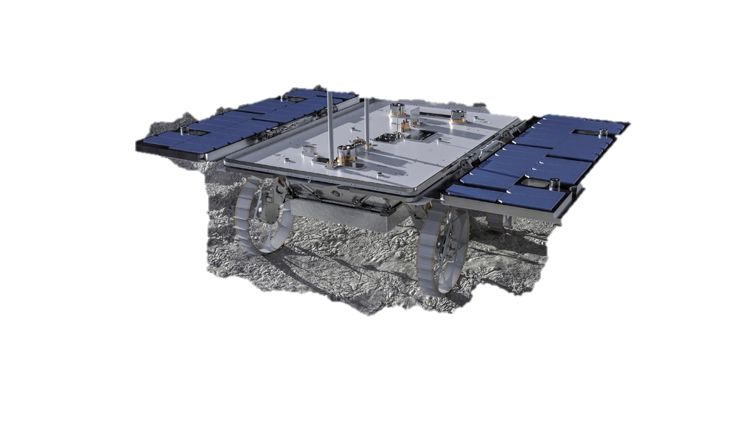
VIPER B
Unity
VIPER A
Omniverse
SOS
CADRE
Unreal Engine
DEMONSTRATION USE CASE:
ROVER RESCUE MISSION

Slide 3
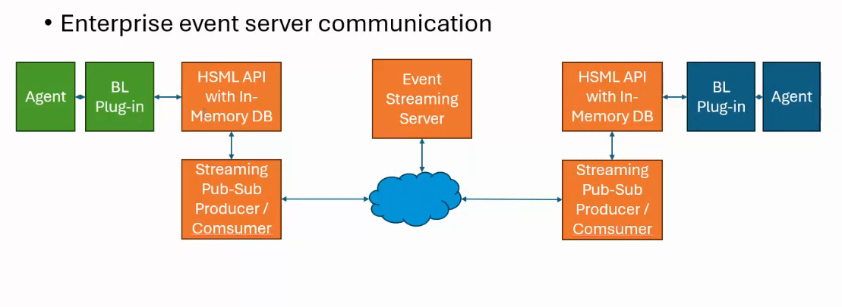
Use Case Elements
ROVER RESCUE MISSION: A rover pushes another rover out of a ditch.
Minimum 2 Platforms & 2 Rovers: Omniverse (VIPER) & Unreal Engine (CADRE)
3 Platforms & 3 Rovers: Unity (VIPER B), Omniverse (VIPER A) & Unreal (CADRE)
2 different Physics engines working together: PhysX in Omniverse & Chaos Physics in Unreal Engine
Assumption: Each party already has the Moon terrain
Pour 1 model in Unreal (Cadre), and another in Omniverse (Viper). Physics needed in both sides.
Take whatever software transform needed to have physical interaction in the system. It needs to simulate Force passed through (collision) and so on.

Slide 4
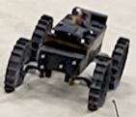
Digital Twin Interoperability Use Case
Viper A
SOS
Viper Rover (Viper A) is in the vicinity.
Viper A receives rescue instruction.
Viper starts Rescue Activity, receiving access to Cadre Agent and latest data.
Cadre
Cadre Rover is in a ditch.
Cadre sends out SOS signal.

Slide 5
Digital Twin Interoperability Use Case
Viper B
Viper A
Path Plan
Viper A moves to the edge of the crater.
Viper A surveys the crater 3D geometry.
Viper A sends 3D geometry to Krono (or PINN) for slope regolith friction simulation.
Viper A sends request to LLM for path planning.
Another Viper rover (Viper B) come to assist the rescue operation.
Cadre
Cadre and Viper A establishes communication.
Cadre sends Viper the information on the surrounding environment.

Slide 6
Digital Twin Interoperability Use Case
Viper B
Path Plan
Viper A
Viper A moves down to the crater.
Viper B moves to the edge to establish a communication relay.
Viper A uses vision to survey the local area.
Viper A sends 3D geometry and images to Viper B for LLM to provide angle of contact with Cadre.
Viper B relays the best angle of push and path plan to Viper A.
Cadre

Slide 7
Digital Twin Interoperability Use Case
Viper B
Path Plan
Viper A moves to the back side of Cadre.
Cadre gives away control to Viper A
Viper A slowly contacts the back of Cadre.
Viper A instructs Cadre to steer its wheels to the planned direction.
Viper A starts pushing Cadre.
Viper A
Cadre

Slide 8
Digital Twin Interoperability Use Case
Viper B
Viper A
Path Plan
Cadre
Viper A pushes Cadre to the edge of the crater.
Rescue mission success!

Slide 9
ACTIVITY OVERVIEW
Step 1. CADRE rover sends an SOS message after getting stuck in a ditch while conducting its operations. VIPER A is in the vicinity and receives the message.
Step 2. VIPER A goes to the crater where CADRE is located and stops at the edge. VIPER assesses the crater, measures the slope, and sends 3D geometry to Krono (or PINN) for slope regolith friction simulation. Viper A sends request to LLM for path planning.
Step 3. Another Viper rover (VIPER B) come to assist the rescue operation. VIPER A receives plan of action (path planning using LLM).
Step 4. VIPER A goes in the crater. VIPER B moves to the edge to establish communication relay.
Step 5. VIPER A reassesses the crater bottom environment and Cadre position. Viper A requests path planning using LLM again.
Step 6. VIPER A collides with CADRE. CADRE lets go of control and follows VIPER A instructions to move wheels. CADRE send information about environment to VIPER.
Step 7. VIPER A pushes CADRE out of the crater, or at least enough to get it back moving.
Step 8. Both VIPER A and CADRE are out of the crater.

Slide 10
ACTIVITY BREAKDOWN
Step 1. CADRE rover sends an SOS message after getting stuck in a ditch while conducting its operations. VIPER A is in the vicinity and receives the message.
An Activity is registered for Viper A to go in to help, describing goal.
A Credential is issued. VIPER A is given access to CADRE, and CADRE to VIPER.
Models are downloaded in the corresponding platform
CADRE in Unreal with Chaos Physics
VIPER A in Omniverse with PhysX
Step 2. VIPER A goes to the crater where CADRE is located and stops at the edge. VIPER assesses the crater, measures the slope, and sends 3D geometry to Krono (or PINN) for slope regolith friction simulation. Viper A sends request to LLM for path planning.
VIPER A and CADRE digital twins are synchronized.
CADRE sends information to VIPER, about environment.
VIPER A sends 3D geometry to Krono (or PINN) for slope regolith friction simulation.
VIPER A sends request to LLM for path planning.

Slide 11
ACTIVITY BREAKDOWN
Step 3. Another Viper rover (VIPER B) come to assist the rescue operation. VIPER A receives plan of action (path planning using LLM).
VIPER B and VIPER A digital twins are synchronized (and therefore also CADRE’s)
Another Activity and Credential are issued. VIPER B is given access to both VIPER A and CADRE
Models are downloaded in the corresponding platform
CADRE in Unreal with Chaos Physics
VIPER A in Omniverse with PhysX
VIPER B in Unity with PhysX
Step 4. VIPER A goes in the crater. VIPER B moves to the edge to establish communication relay.
VIPER B and VIPER A send data back and forth (visual data of the terrain, slip in the wheels…). This data modifies the simulation of the physical environment.
VIPER A follows path plan from LLM, depending on inclination may need to zigzag
VIPER B sends to VIPER A the angle at which it should collide with CADRE

Slide 12
ACTIVITY BREAKDOWN
Step 5. VIPER A collides with CADRE. CADRE lets go of control and follows VIPER A instructions to move wheels. CADRE sends information about environment to VIPER.
VIPER A force (from PhysX) is transferred to CADRE (in Chaos Physics)
CADRE leaves control to VIPER A and follow its commands (wheel’s rotational speed)
CADRE sends through VIPER A to VIPER B new visual data.
Step 6. VIPER A pushes CADRE out of the crater, or at least enough to get it back moving.
Krono estimate torch and friction from both VIPER A and CADRE together, LLM plans the path up
New updated path plan out of the crater is sent to VIPER A via VIPER B
VIPER A and CADRE follow path plan out of the crater.
Step 7. Both VIPER A and CADRE are out of the crater.

Slide 13
Digital Twin Interoperability Use Case
Configure Server and topics needed to send the different messages
Define method to store and download 3D models (database or other)
HSML Implementation into the 3 Platforms
In-memory database along with Kafka
Program to measure latency. Optimize sent messages to minimize data exchange.
Authentication Process for Kafka and HSML Entities
Viper A
Tasks:
SOS
Viper Rover (Viper A) is in the vicinity.
Viper A receives rescue instruction.
Viper starts Rescue Activity, receiving access to Cadre Agent and latest data.
Cadre
Cadre Rover is in a ditch.
Cadre sends out SOS signal.
Tasks:
Select crater from Lunar Surface Environment to conduct the Use Case.
Simulation within platforms (1) Omniverse, (2) Unity, (3) Unreal Engine of the sequence of operations using a Manual Control – Check Feasibility of Experiment
Simulation within platforms, but now the control is done using scripts.

Slide 14
Digital Twin Interoperability Use Case
Viper B
Viper A
Path Plan
Viper A moves to the edge of the crater.
Viper A surveys the crater 3D geometry.
Viper A sends 3D geometry to Krono (or PINN) for slope regolith friction simulation.
Viper A sends request to LLM for path planning.
Another Viper rover (Viper B) come to assist the rescue operation.
Cadre
Cadre and Viper A establishes communication.
Cadre sends Viper the information on the surrounding environment.
Tasks:
Path planning using LLMs and Krono. Test for VIPER rover based on different craters.
Business Logic conversion (LLM). Develop the Unity, Unreal and Omniverse Plugins
Build AI agent that speaks Chaos Physics and converts to PhysX, and vice versa.

Slide 15
Digital Twin Interoperability Use Case
Viper B
Path Plan
Viper A
Viper A moves down to the crater.
Viper B moves to the edge to establish a communication relay.
Viper A uses vision to survey the local area.
Viper A sends 3D geometry and images to Viper B for LLM to provide angle of contact with Cadre.
Viper B relays the best angle of push and path plan to Viper A.
Cadre
Tasks:
Path planning (upwards) using LLMs and Krono for both VIPER A and CADRE.

Slide 16
Digital Twin Interoperability Use Case
Viper B
Path Plan
Viper A moves to the back side of Cadre.
Cadre gives away control to Viper A
Viper A slowly contacts the back of Cadre.
Viper A instructs Cadre to steer its wheels to the planned direction.
Viper A starts pushing Cadre.
Viper A
Cadre
Tasks:
Get 2 different physics engines (PhysX and Chaos Physics) working together (collision, force)

Slide 17
Digital Twin Interoperability Use Case
Viper B
Viper A
Path Plan
Cadre
Viper A pushes Cadre to the edge of the crater.
Rescue mission success!

Slide 18
DATA TO BE EXCHANGED
SOS signal
Position/rotation, and speed of rovers
Rotational speed of rover wheels
Sensor data: Visual data, 3D geometry and images
Path Plan
Angle of contact
Slip ratio
Signal frequency, signal strength
Status of instruments
Force
[…]

Slide 19
Software Architecture
Enterprise event server communication
Agent
BL Plug-in
HSML API with In-Memory DB
Event Streaming Server
HSML API with In-Memory DB
BL Plug-in
Agent
Streaming Pub-Sub Producer / Comsumer
Streaming Pub-Sub Producer / Comsumer

Slide 20
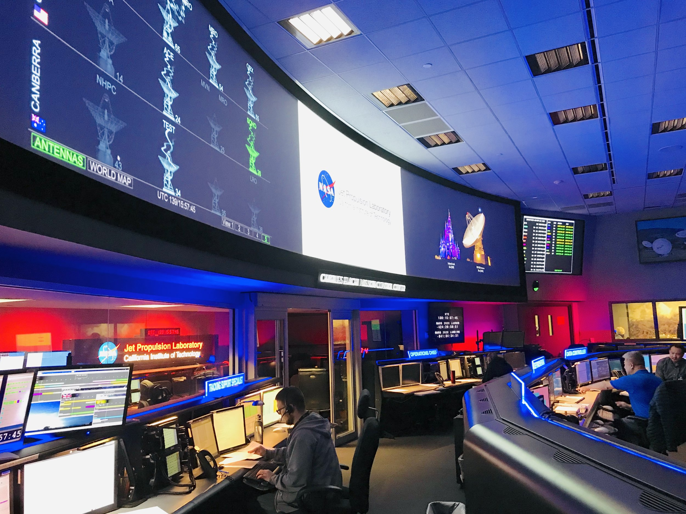
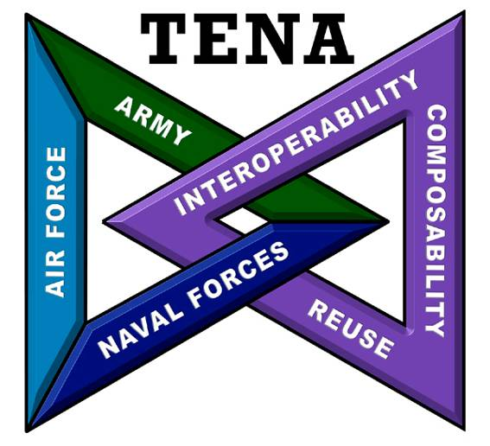
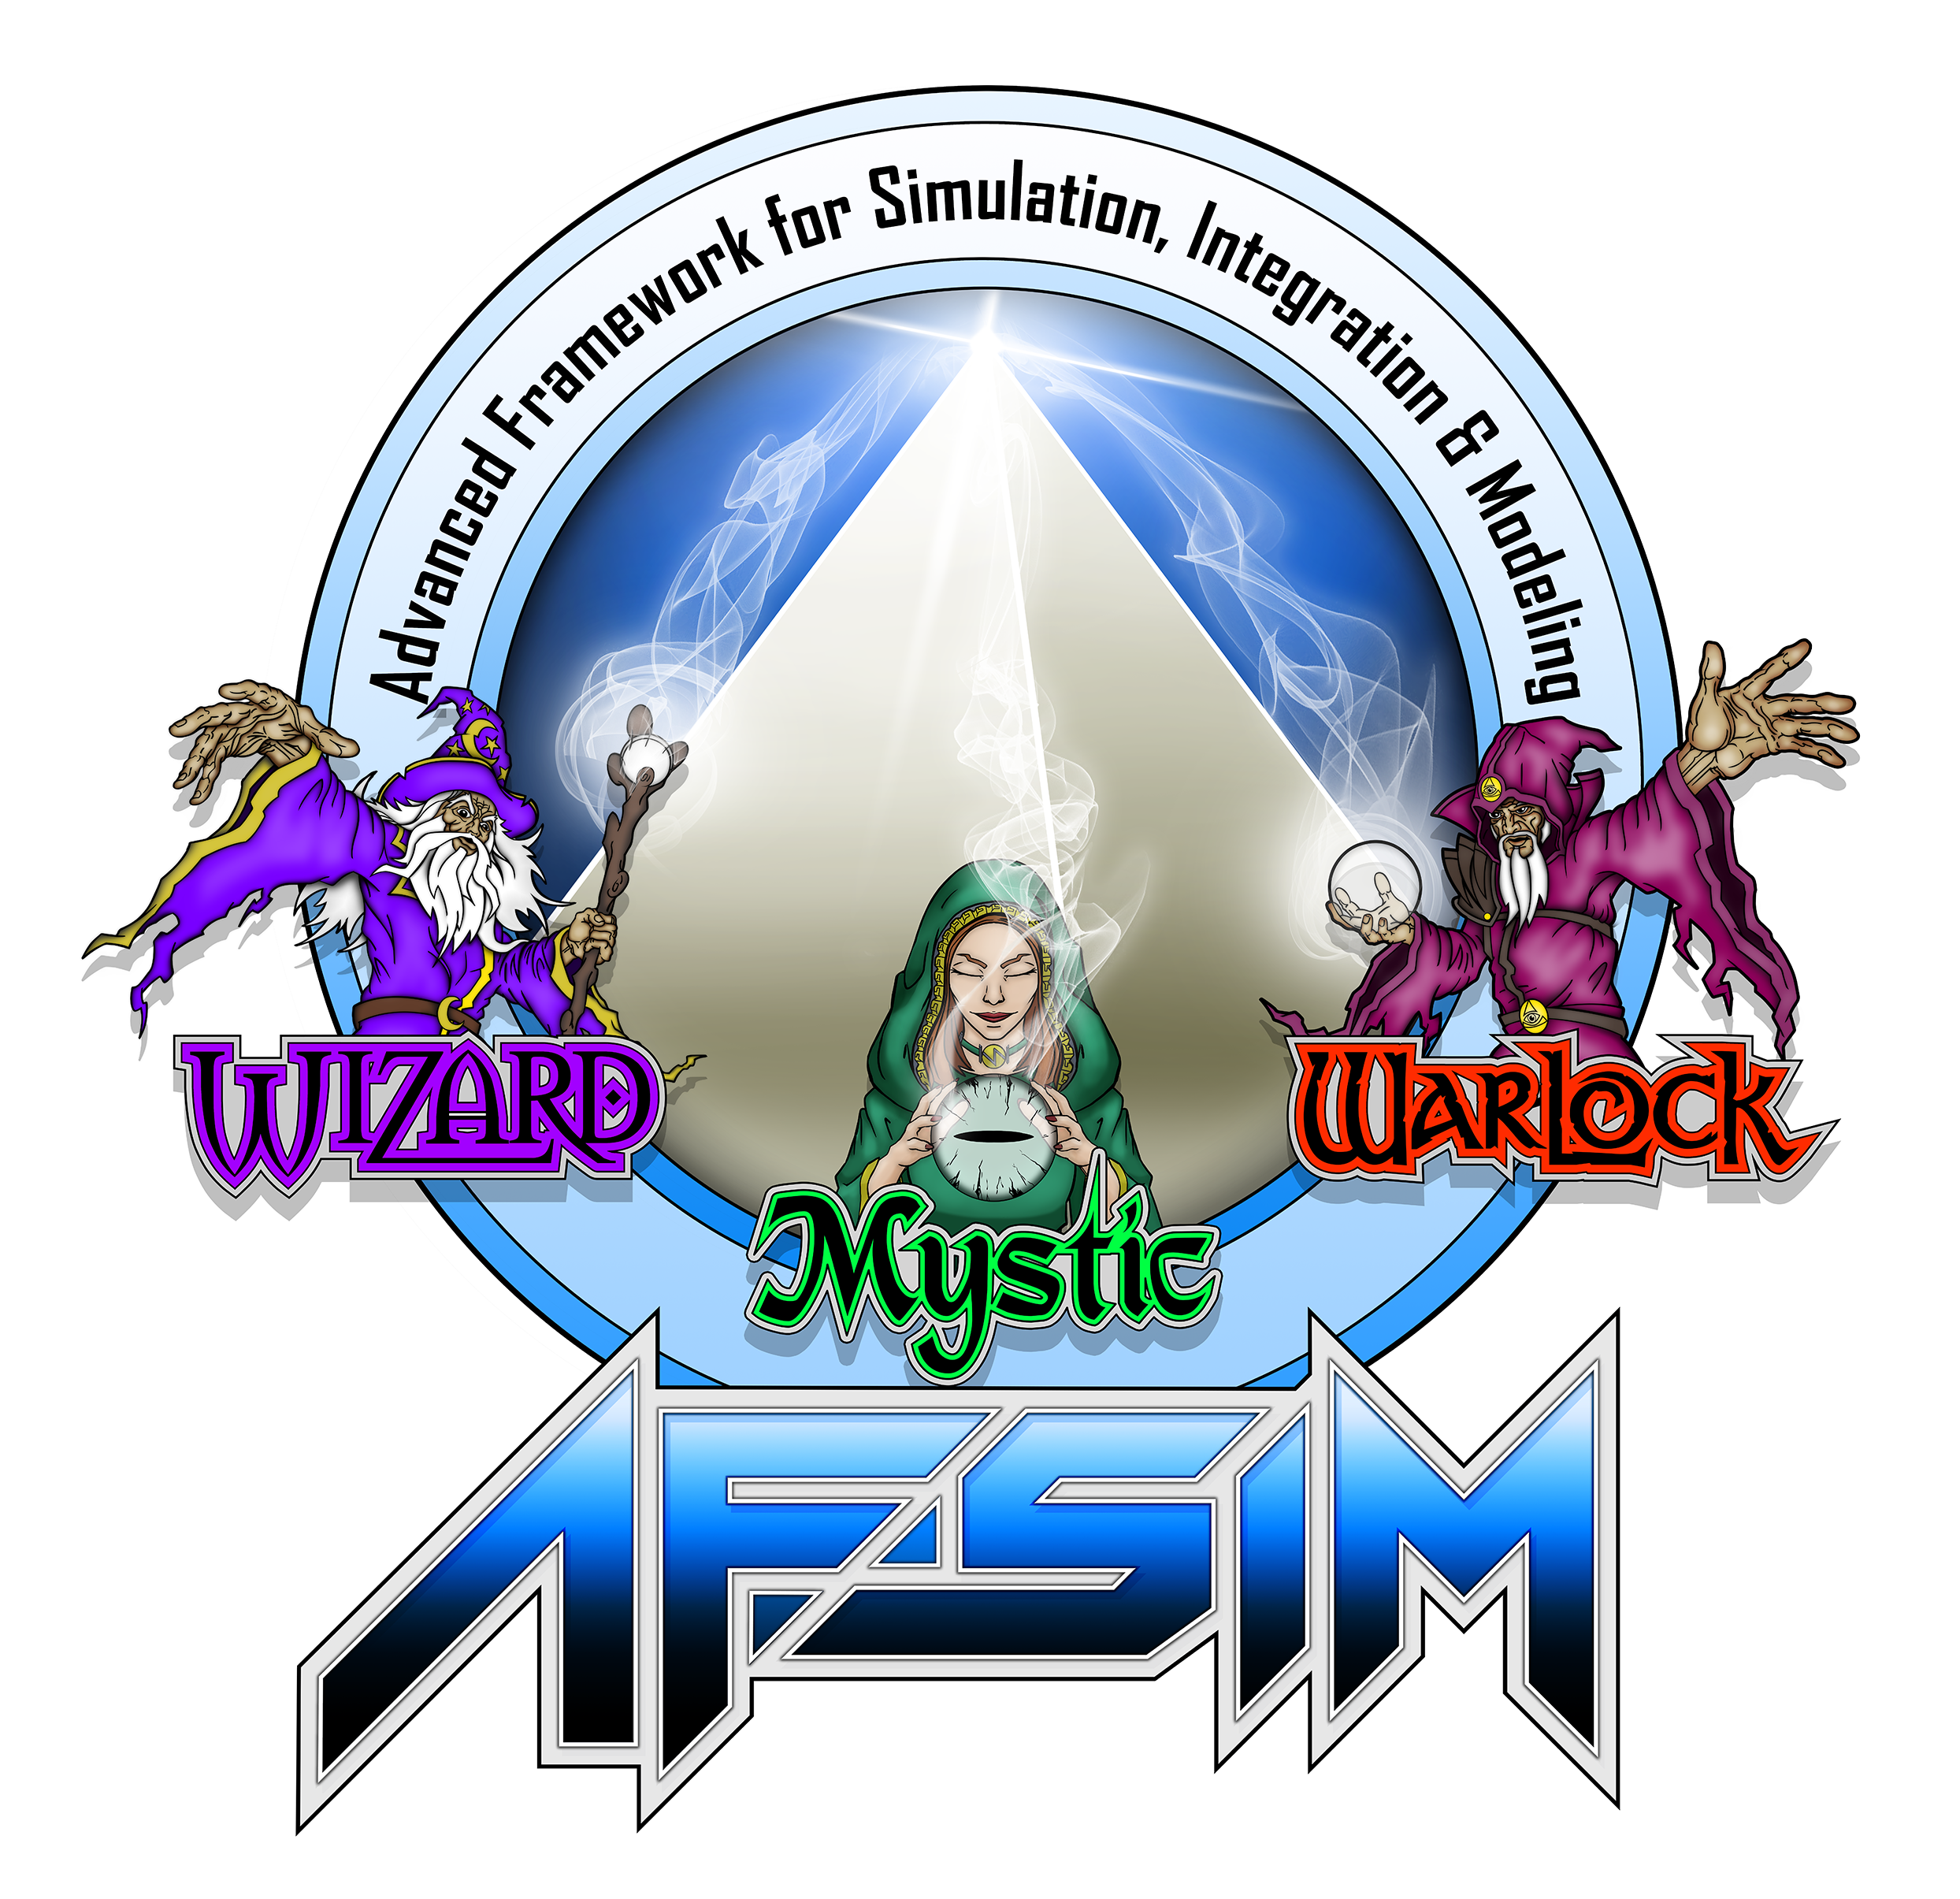
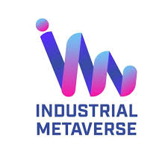
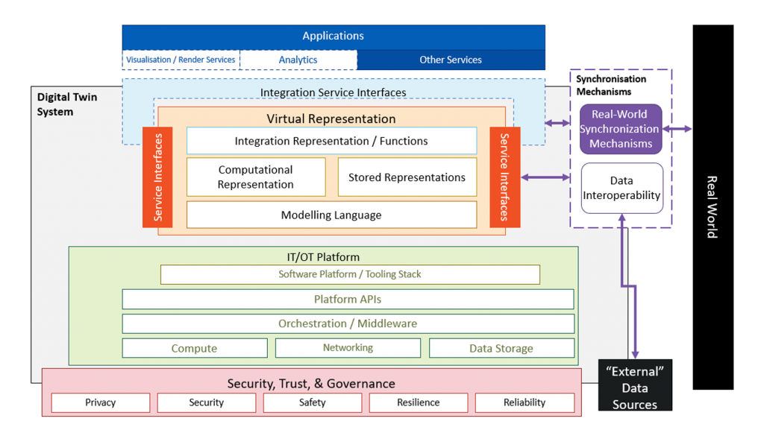
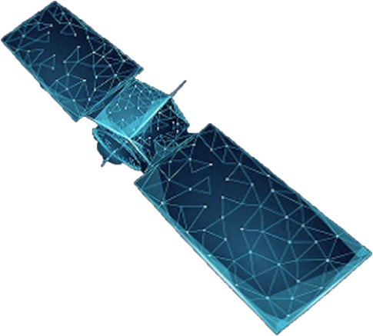
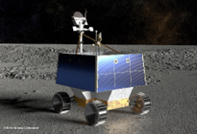
Pilot Network Architecture
Decentralized protocol enables cost reduction and better security for Digital Twin implementations
Trusted AI agent support real-time operations using small models and dynamically fine-tuned models selected based on context
Extensible common data format
File header, Digital Twin Header, Data
Unique Data Identifier – Category, Attribute, Tag
Data type, format, and size
Human & AI Domain Expert Agents
External Sim Systems
Trusted AI Agent
Trusted AI Agent
Trusted AI Agent
Trusted AI Agent
Open Schema & Unique Data Identifier
Digital Twin Interoperability Services
Network
(Web3)
Model Gateway
Common Model Library
Common Tool Library
Distributed Streaming Server
Physical System and Digital Twins
Others

Slide 21
TASKS
Configure Server and topics needed to send the different messages (Group 1)
Define method to store and download 3D models (database or other) (Group 1)
HSML Implementation into the 3 Platforms (Group 3)
In-memory database along with Kafka (Group 1,3)
Program to measure latency. Optimize sent messages to minimize data exchange. (Group 1)
Authentication Process for Kafka and HSML Entities (Group 3)
Select crater from Lunar Surface Environment to conduct the Use Case. (Group 2)
Simulation within platforms (1) Omniverse, (2) Unity, (3) Unreal Engine of the sequence of operations using a Manual Control – Check Feasibility of Experiment (Group 2)
Simulation within platforms, but now the control is done using scripts. (Group 2)
Path planning using LLMs and Krono. Test for VIPER rover based on different craters. (Group 2)
Business Logic conversion (LLM). Develop the Unity, Unreal and Omniverse Plugins (Group 4)
Build AI agent that speaks Chaos Physics and converts to PhysX, and vice versa. (Group 4)
Get 2 different physics engines (PhysX and Chaos Phsyics) working together (collision, force) (Group 2)

Slide 22
ASSIGNING TASKS
Four Groups – Leaders: 1.Sub: Kafka server, In-memory database; measure latency & min data stream 2.Jared: Omniverse, Unreal and Unity environments, Different Physics engines working together; Model storage 3.Alicia: HSML Implementation; Model storage; Authentication protocol 4.Gerald: Business Logic Plugins; AI agent; Model storage
Software system engineering, define interface control document.
Divide the Tasks between 7 new interns: •1 or 2 new interns work on both PhysX and Chaos Physics, how to make them work together. •1 new intern should build a very simple AI agent. •2 in Krono and Omniverse connection and using LLMs for Path Planning •1 or 2 in Collision Models across the Server, how to release control •1 or 2 in Unity and Omniverse (using PhysX), Viper B helping Viper A. •

Slide 23
GROUP 1: Kafka server, In-memory database; measure latency & min data stream
Group Leader: Sub
TASKS:
Task 1. Configure Server and topics needed to send the different messages
Task 2. Define method to store and download 3D models (database or other)
Task 4. In-memory database along with Kafka
Task 5. Program to measure latency. Optimize sent messages to minimize data exchange.
Interns on this Group: ….. (at least 1 or 2 more)…..

Slide 24
GROUP 2: Omniverse, Unreal and Unity environments, Different Physics engines working together; Model storage
Group Leader: Jared
TASKS:
Task 7. Select crater from Lunar Surface Environment to conduct the Use Case.
Task 8. Simulation within platforms (1) Omniverse, (2) Unity, (3) Unreal Engine of the sequence of operations using a Manual Control – Check Feasibility of Experiment
Task 9. Simulation within platforms, but now the control is done using scripts.
Task 10. Path planning using LLMs and Krono. Test for VIPER rover based on different craters.
Task 13. Get 2 different physics engines (PhysX and Chaos Phsyics) working together (collision, force)
Interns in this Group: …… (at least 4) ….

Slide 25
GROUP 3: HSML Implementation; Model storage; Authentication protocol
Group Leader: Alicia
TASKS:
Task 3. HSML Implementation into the 3 Platforms
Task 4. In-memory database along with Kafka (& with the HSML API)
Task 6. Authentication Process for Kafka and HSML Entities
Interns in this Group: …… (maybe 1 or 2) ….

Slide 26
GROUP 4: Business Logic Plugins; AI agent; Model storage
Group Leader: Gerald
TASKS:
Task 11. Business Logic conversion (LLM). Develop the Unity, Unreal and Omniverse Plugins
Task 12. Build AI agent that speaks Chaos Physics and converts to PhysX, and vice versa. (Group 4)
Interns in this Group: …… (maybe 1 or 2) ….

Slide 27
Development Schedule
Tasks | Team | 2/10 | 2/17 | 2/24 | 3/3 | 3/10 | 3/17 | 3/24 | 3/31 | 4/7 | 4/14
Complete In-memory DB (Apache Ignite) setup and evaluation (1, 5) | Sub
Complete In-memory DB and Pub-sub (Kafka) integration (2, 4) | ASB, Sub
Complete HSML API with In-memory DB (3, 6) | ASB, Sub
Develop two lunar rover models in Omniverse (7) | JC
Issac sim modeling of the rover push stuck rover scenario (8, 9) | JC
Port models (FBX, OBJ) to Unreal Engine and Autodesk | JC
Define business logic for the use case (Omniverse-Unreal, Omniverse-Fusion 360) (11) | GP, JC
Develop physics simulation for Omniverse (Issac Sim PhyX) - Unreal (AirSim PhyX) (10) | GP, ASB
Spiral 1 Use case integration testing (socket connection, without HSML) (1) | GP, JC
* Develop physics simulation for Omniverse (Issac Sim PhyX) - Autodesk (Fusion 360) (~13) | GP, ASB
Business logic and physics integration with HSML API (11, 12) | GP, ASB
Spiral 2 Use case integration testing with pub-sub messaging using HSML (1) | GP,JC,SC, ASB
Develop AI agents using Langchain, Ollama, or others(retrieval, function call, memory) (12) | GP
AI agent integration with business logic (12) | GP
Spiral 3 Use case integration testing with AI agents HSML | All
Refine demo and clean up code | All
Demo dry run | All
Evaluate layer 2 blockchain (zkSync, Lookring, etc.) | ?
Develop layer 2 blockchain integration with pub-sub | Sub, ?
Laboratory testing of layer 2 blockchain and pub-sub | Sub, ?
z
4/16
4/9

